Slide 1
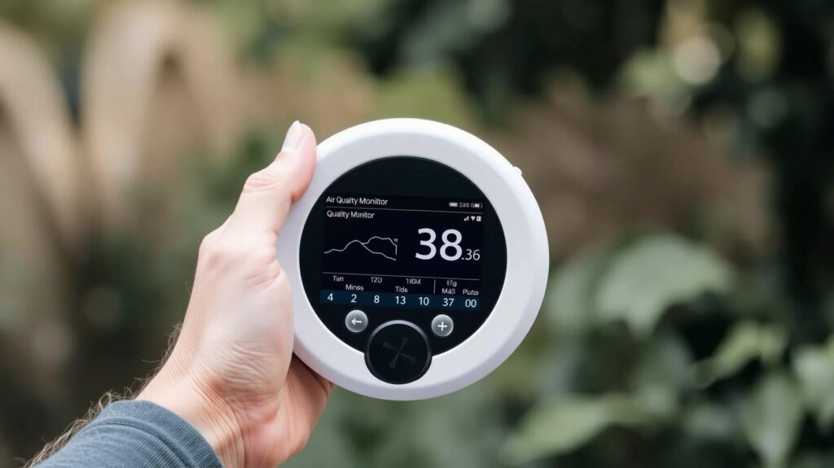
Real Time Environmental Parameters Display

Slide 2

Real Time Environmental Parameters Display
Session:- 2025-2026
Submitted By:-
Ms.Avantika K. Yerawar Mr.Pranay V. Jadhao
Ms.Riya S. Wankhede Mr.Lokesh K. Chirde
Mr.Uday P. Nalhe Ms.Gauri B. Chapke
Ms.Tanvi A. Bijwe
Project Guide
Dr. P. M. Pandit

Slide 3
CONTENT
ABSTRACT
INTRODUCTION
PROBLEM STATEMENT
OBJECTIVE
LITERATURE REVIEW
RESEARCH METHODOLOGY
SYSTEM REQUIREMENT
ADVANTAGES & APPLICATIONS
EXPERIMENTAL SETUP & RESULT
CONCLUSION & FUTURE SCOPE
REFERENCES

Slide 4
ABSTRACT
The monitoring of environmental parameters in real time is essential for ensuring healthy and sustainable living conditions. This seminar focuses on the design and implementation of a low-cost, scalable system for real-time environmental parameter display using ESP32. The proposed system integrates multiple sensors, including temperature, humidity, CO₂, and dust particle sensors, to measure critical atmospheric parameters. Data from these sensors is processed by the ESP32 microcontroller and displayed on a local output device such as a 7-segment display, eliminating the need for mobile or cloud-based platforms. The hardware setup consists of DHT11 for temperature and humidity, MQ-135 for CO₂ concentration, and optical dust sensors for particulate matter detection. The simplicity of the ESP32 platform ensures ease of deployment, while the modular design supports customisation for a wide range of applications. This work demonstrates that ESP-based systems can provide accurate and reliable monitoring of environmental conditions at low cost, making them highly suitable for laboratories, classrooms, offices, and community spaces. The system serves as a practical solution for real-time monitoring where portability, independence from mobile networks, and cost efficiency are priorities.

Slide 5
INTRODUCTION
Air pollution is the biggest problem of every nation, whether it is developed or developing.
Health problems have been growing at faster rate especially in urban areas of developing countries where industrialization and growing number of vehicles leads to release of a lot of gaseous pollutants.
Harmful effects of pollution include mild allergic reactions such as irritation of the throat, eyes and nose as well as some serious problems like bronchitis, heart diseases, pneumonia, lung and aggravated asthma.
Here to make an Air Pollution Monitoring System in which we will monitor the Air quality and will trigger an alarm when the air quality goes down beyond a certain level, means when there are sufficient amount of harmful gases are present in the air like CO2, smoke, alcohol ,benzene and NH3.
It will show the air quality in PPM on the 4 bit LED so that we can monitor it very easily. \
MQ2 sensor which is the best choice for monitoring Air Quality as it can detect most harmful gases and can measure their amount accurately.
When pollution goes beyond some level, it triggers an alert through a buzzer.

Slide 6
PROBLEM STATEMENT
Increasing levels of air pollution and environmental imbalance pose serious risks to human health and safety, especially in indoor and industrial environments.
Parameters such as carbon dioxide concentration, dust particles, temperature, and humidity often exceed safe limits without immediate notice, leading to health issues like respiratory problems, discomfort, and reduced productivity.
Conventional monitoring methods are either manual, expensive, or fail to provide real-time alerts, making it difficult to respond promptly to hazardous conditions.
Therefore, there is a need for a low-cost, real-time embedded system that can continuously monitor critical environmental parameters and provide instant alerts when threshold values are exceeded.
Such a system can help ensure a safer and healthier environment by enabling timely preventive action.

Slide 7
PROPOSED SOLUTION
Develop a real-time environmental monitoring system using ESP32 and multiple sensors.
Sensors such as DHT11, MQ-135, and dust sensors collect environmental data.
The ESP32 microcontroller processes the sensor data and converts it into readable values.
The measured parameters are displayed in real time using LCD or display modules.
This system provides a low-cost, flexible, and easy-to-implement solution for monitoring environmental conditions.

Slide 8

OBJECTIVES
To design and develop an embedded system for real-time monitoring of environmental parameters.
To measure CO₂ concentration and dust particle levels using MQ2 sensors.
To monitor temperature and humidity using the DHT11 sensor.
To process and display sensor data continuously using an ESP32 controller.
To implement a threshold-based alert system using a buzzer for hazardous conditions.
To provide a low-cost and reliable solution for environmental safety monitoring.
To enhance awareness and timely response to unsafe environmental conditions.

Slide 9
LITERATURE REVIEW
SR.NO | AUTHOR | TITLE | JOURNAL | FINDING
1 | M. Deepshika, et al., | “Real Time Air Quality Monitoring System” | Anil Neerukonda Institute Of Technology And Sciences. 2021. | They studies commonly utilize embedded systems and IoT-based platforms with microcontrollers such as Arduino and ESP modules integrated with MQ series gas sensors to detect harmful gases like CO₂, CO, and other air pollutants.
2 | Thanushree D, et al., | “Air Quality Detection using Embedded Systems” | International Journal of Advanced Research in Computer and Communication Engineering Vol. 10, Issue 7, July 2021 | They presented an air quality detection system using embedded technology aimed at monitoring environmental pollution in real time.

Slide 10
3 | Yeshvant.Ba, et al., | “Real Time Temperature And Humidity Monitoring System” | Student Journal of Electrical and Electronics Engineering Issue No. 1, Vol. 1, 2022. | They presented a real-time temperature and humidity monitoring system using embedded system technology to continuously observe environmental conditions.
4 | Fatima Khan, et al., | “IoT-Driven Pollution Detection System for Indoor and Outdoor Environments | Tech science Press. Volume 86, Issue 2, 9 December 2025. | They proposed an IoT-driven pollution detection system designed to monitor air quality in both indoor and outdoor environments using smart sensing and internet connectivity.
5 | Osama Alsamrai, et al., | “Real-Time Intelligent Monitoring of Outdoor Air Quality in an Urban Environment Using IoT and Machine Learning Algorithms” | Appl. Sci. 2025. | They proposed a real-time intelligent air quality monitoring system for urban environments by combining IoT sensing technology with machine learning algorithms.

Slide 11
RESEARCH METHODOLOGY
The proposed system is designed to provide real-time monitoring of environmental parameters using an embedded system platform.
It is based on the ESP32 microcontroller, which serves as the central controller for processing sensor data and controlling alert mechanisms.
The system integrates MQ2 sensor to detect CO₂ levels and dust particles, providing an accurate measure of air quality.
Additionally, a DHT11 sensor is used to monitor temperature and humidity, giving a complete view of environmental conditions.
All sensor data is continuously read and processed by the controller.
To enhance user interaction, a 4-digit LED display is added to show real-time values of parameters such as temperature, humidity, and air quality levels.
This allows users to easily view the readings directly on the device.
When any parameter exceeds its predefined threshold, the system immediately triggers a buzzer alert while also displaying the warning values on the LED display, notifying users of unsafe conditions.

Slide 12
SYSTEM REQUIREMENT
HARDWARE REQUIREMENT
ESP 32 Microcontroller
MQ-135 Sensor
DHT11 Sensor
Buzzer
TM1637 4 Bits LED Display * 4
SOFTWARE REQUIREMENT
Arduino IDE
Proteus

Slide 13
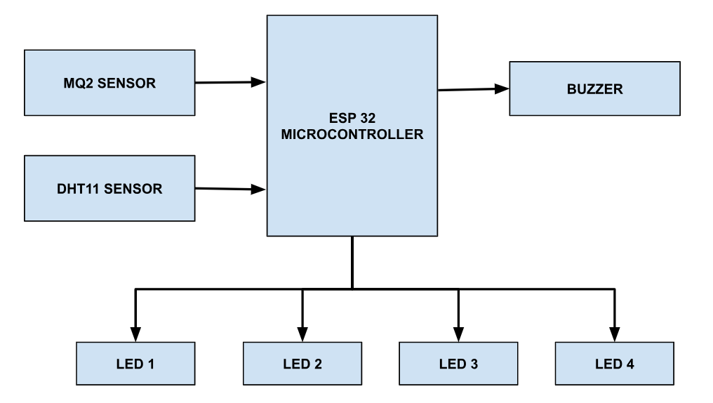
BLOCK DIAGRAM
DESCRIPTION
In this project we have used an ESP32 Microcontroller, In input we have MQ2 Sensor and DHT11 Sensor . In output we have four 4 bit LED display and buzzer for alert generation.
Fig. 1 Shows the Block Diagram of the System

Slide 14
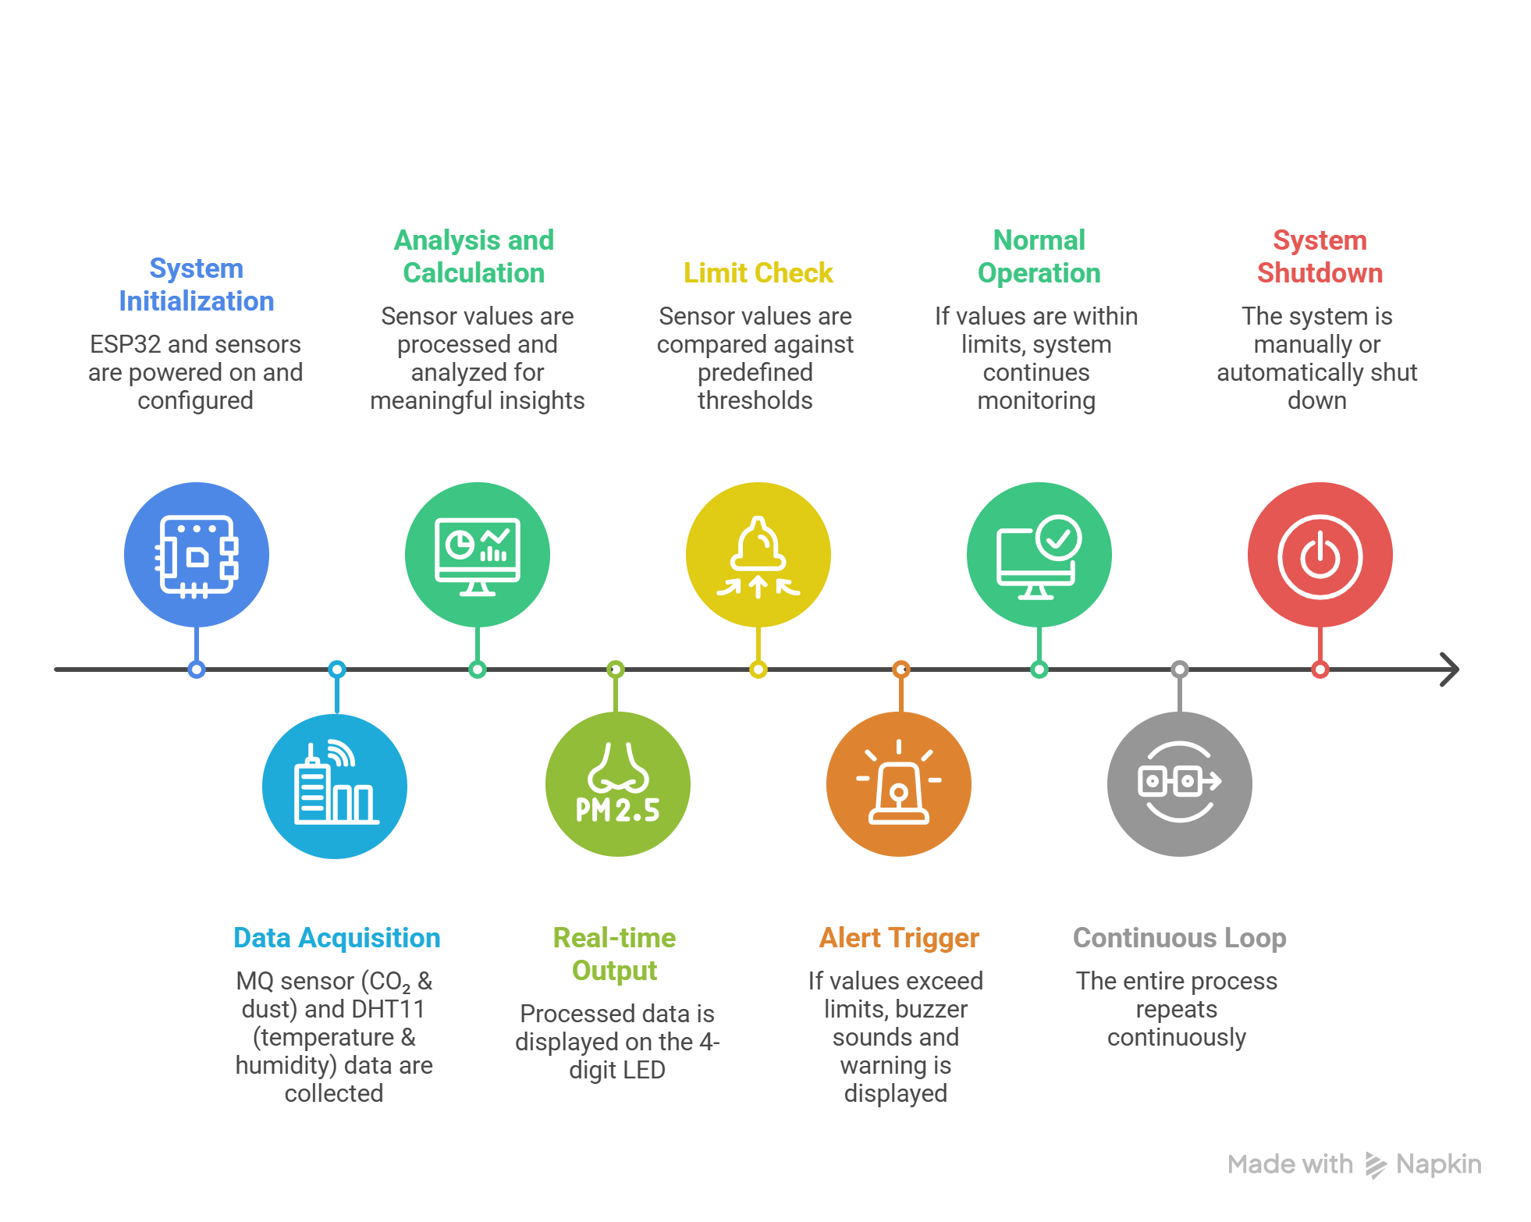
FLOWCHART
Fig. 2 Shows the flowchart of the System

Slide 15
WORKING
The proposed system works by continuously monitoring environmental parameters using the ESP32 microcontroller as the central processing unit.
Initially, all sensors including the MQ2 sensor and DHT11 sensor are initialized. The MQ2 sensor detects the concentration of CO₂ and dust particles in the air, while the DHT11 sensor measures temperature and humidity.
These sensor readings are collected by the ESP32 and processed in real time.
The processed data is then displayed on a 4-digit LED display, allowing users to easily observe current environmental conditions.
The system continuously compares the sensed values with predefined threshold limits to determine air quality safety levels.
If any parameter such as gas concentration, temperature, or humidity exceeds the safe limit, the ESP32 immediately activates a buzzer to alert users about the unsafe condition.
At the same time, the warning values are displayed on the 4 bit LED display for quick identification.
If all parameters are within safe limits, the system continues normal monitoring without triggering any alert.

Slide 16
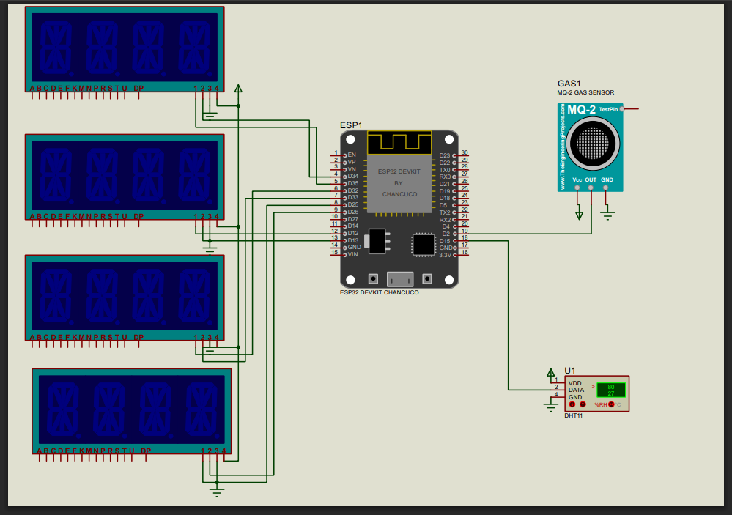
CIRCUIT DIAGRAM

Slide 17
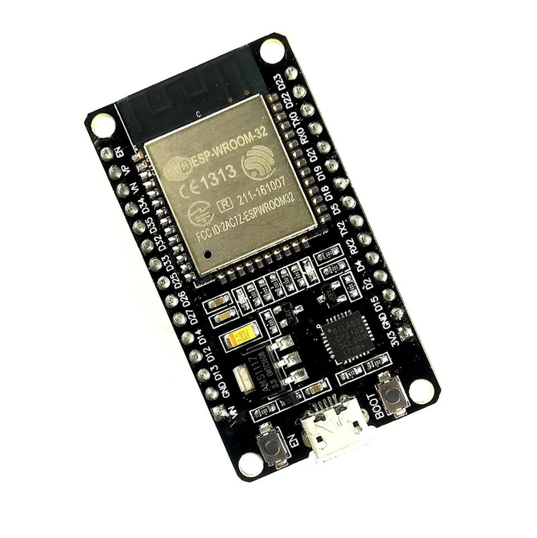
ESP32 MICROCONTROLLER
The NodeMCU ESP32 board is a versatile development platform widely used in IoT (Internet of Things) projects.
It integrates the ESP32 microcontroller, which features dual-core processing, Bluetooth, Wi-Fi connectivity, and ample GPIO pins.
The board supports a variety of programming environments including Arduino IDE and MicroPython, making it accessible for both beginners and experienced developers.

Slide 18
ESP32 FEATURES
NodeMCU based on ESP-WROOM-32 module
30 GPIO Version
ESP32 is a dual-core 32-bit processor with built-in 2.4 GHz Wi-Fi and Bluetooth
4 MByte flash memory
520 KByte SRAM
2.2 to 3.6V Operating voltage range
In breadboard-friendly breakout
USB micro B for power and Serial communication used to load the program and serial debugging too

Slide 19
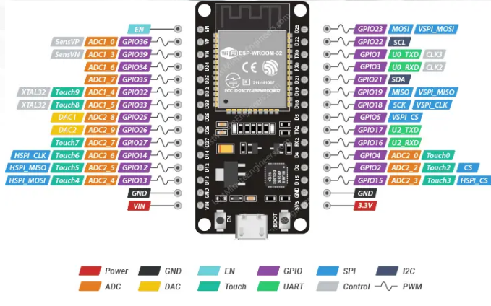
ESP32 PINOUT

Slide 20
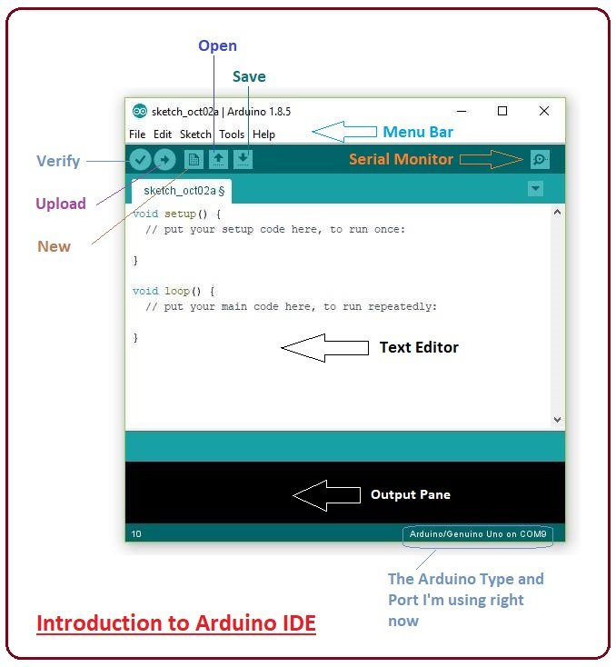
ARDUINO IDE PROGRAMMING SOFTWARE
The Arduino Integrated Development Environment (IDE) is a cross-platform application (for Windows, macOS, Linux) that is written in functions from C and C++. It is used to write and upload programs to Arduino compatible boards, but also, with the help of third-party cores, other vendor development boards.
Arduino code is written in C++ with an addition of special methods and functions, which we'll mention later on. C++ is a human-readable programming language. When you create a 'sketch' (the name given to Arduino code files), it is processed and compiled to machine language.

Slide 21
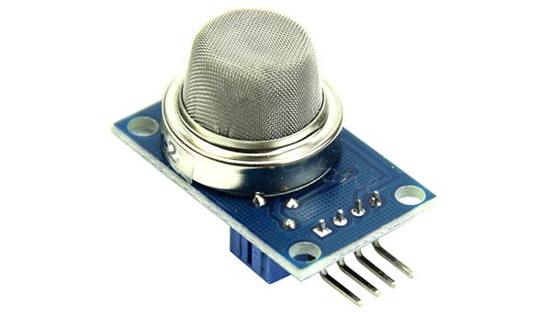
MQ SENSOR
Different Types of Gas sensors
Gas sensors are typically classified into various types based on the type of the sensing element it is built with. Below is the classification of the various types of gas sensors based on the sensing element that are generally used in various applications:
Metal Oxide based gas Sensor.
Optical gas Sensor.
Electrochemical gas Sensor.
Capacitance-based gas Sensor.
Calorimetric gas Sensor.
Acoustic based gas Sensor.

Slide 22
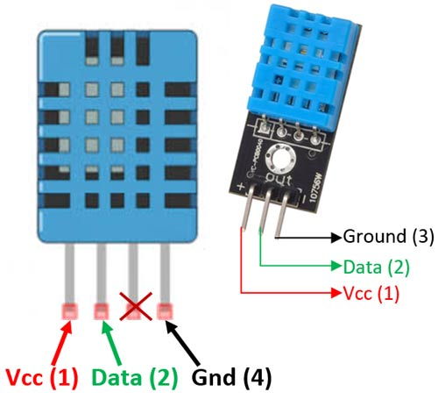
DHT11 SENSOR
The DHT11 is a commonly used Temperature and humidity sensor that comes with a dedicated NTC to measure temperature and an 8-bit microcontroller to output the values of temperature and humidity as serial data.

Slide 23
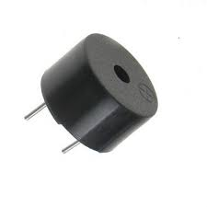
BUZZER
A buzzer or beeper is an audio signaling device, which may be mechanical, electromechanical, or piezoelectric (piezo for short).
Typical uses of buzzers and beepers include alarm devices, timers and confirmation of user input such as a mouse click or keystroke.

Slide 24
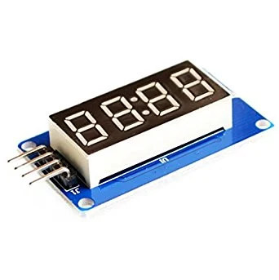
TM1637 DISPLAY
TM1637 is a kind of LED (light-emitting diode display) drive control special circuit with keyboard scan interface and it's internally integrated with MCU digital interface, data latch, LED high pressure drive and keyboard scan.
The TM1637 4 Bits Digital Tube LED Display Module is an affordable solution for displaying the output data of your Arduino project.
Though the data displayed is restricted by numbers still it allows users to display some characters too like A, B, C etc.
This 7 segment LED Display has 4 digits which are controlled by TM1637 Driver Chip.
It requires only two connections to control this TM1637 4 Bits Digital Tube LED Display Module.

Slide 25
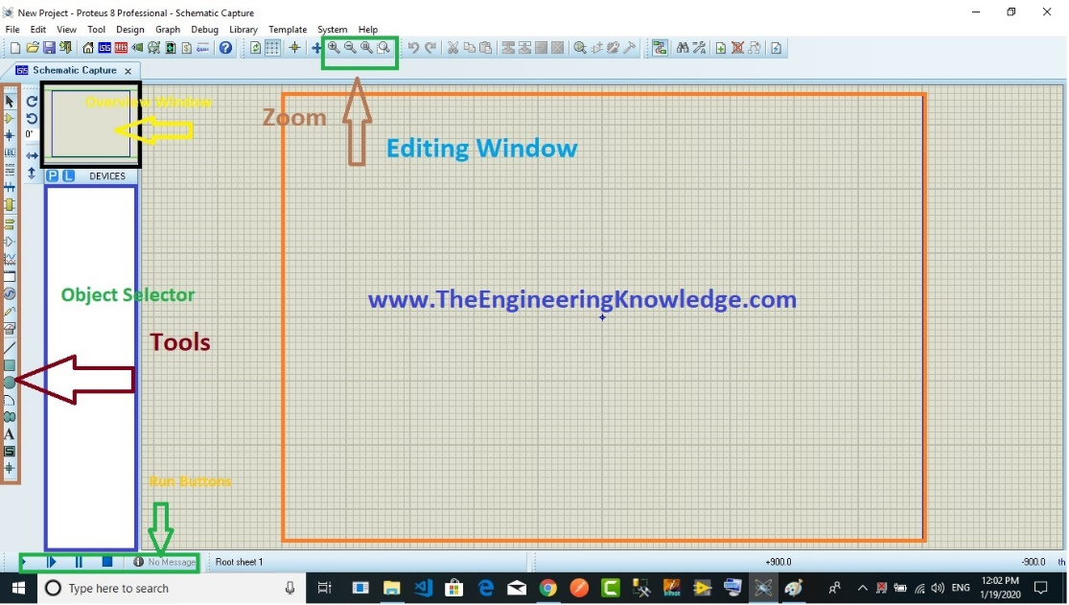
PROTEUS SIMULATION DESIGN SOFTWARE
The Proteus Design Suite is a proprietary software tool suite used primarily for electronic design automation. The software is used mainly by electronic design engineers and technicians to create schematics and electronic prints for manufacturing printed circuit boards.
What is Proteus? Proteus is a work management automation platform designed from the ground-up by diversified energy industry professionals to help the industry digitally transform and transition to a low carbon future. It brings together talent acquisition, project management and finance into one cloud-based hub.

Slide 26
ADVANTAGES
Real-Time Monitoring: Continuously tracks environmental parameters, enabling immediate detection of unsafe conditions.
Early Alert System: Threshold-based buzzer alerts help prevent exposure to harmful gases and poor air quality.
Cost-Effective: Built using affordable components like ESP32, MQ sensors, and DHT11.
Portable and Easy to Deploy: Battery-operated and compact design allows installation in multiple locations.
Low Maintenance: Simple embedded system design with minimal upkeep requirements.
Multi-Parameter Monitoring: Monitors CO₂, dust particles, temperature, and humidity simultaneously, providing a comprehensive environmental overview.

Slide 27
APPLICATIONS
Indoor Air Quality Monitoring: Homes, offices, classrooms, and laboratories to ensure healthy indoor conditions.
Industrial Environments: Factories and workshops to detect gas leaks, dust, and unsafe temperature/humidity levels.
Environmental Research: Collects data for studies on air pollution, climate, and environmental safety.
Smart Buildings: Integrates with embedded systems to automate ventilation or alert systems based on air quality.
Healthcare Facilities: Monitors critical environmental parameters to maintain safe conditions for patients.
Public Spaces: Airports, malls, and metro stations for monitoring indoor air quality and improving public safety

Slide 28
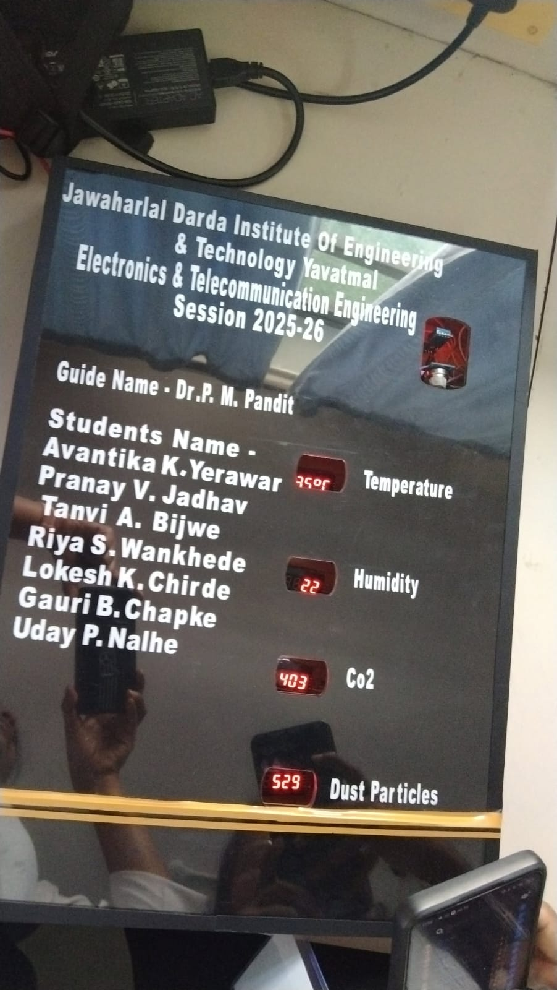
EXPERIMENTAL SETUP
Fig. 3 shows the Top View of the project

Slide 29
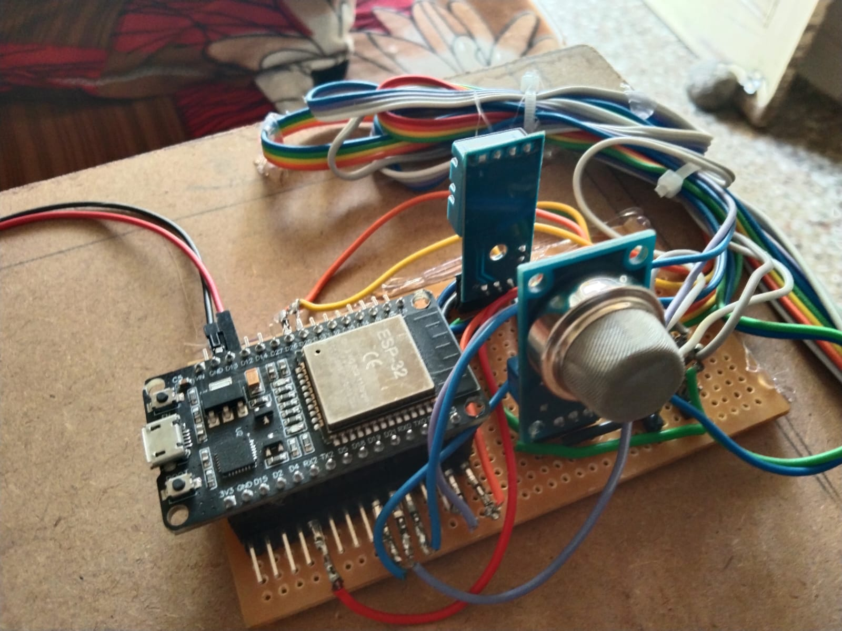
Fig. 4 Shows the experimental setup of the proposed system

Slide 30
RESULTS
The developed Real-Time Environmental Parameters Display system successfully demonstrates the ability to monitor critical environmental parameters, including CO₂ concentration, dust particles, temperature, and humidity, in real time using an ESP 32-based embedded system.
During testing, the system consistently captured sensor data accurately and triggered the buzzer alert whenever any parameter crossed its predefined threshold, proving its effectiveness in detecting potentially hazardous conditions.
The integration of MQ sensor and DHT11 sensor, combined with a simple yet reliable microcontroller platform, ensures low-cost, portable, and efficient operation, making it suitable for a wide range of indoor and industrial applications.
The results indicate that the system can significantly enhance environmental safety awareness, enabling timely intervention to protect human health.

Slide 31
CONCLUSION
The Real-Time Environmental Parameters Display system successfully demonstrates an efficient and reliable method for monitoring critical environmental factors such as CO₂ concentration, dust particles, temperature, and humidity.
By integrating ESP32, MQ sensor, and DHT11, the system provides accurate, real-time data and triggers a buzzer alert whenever thresholds are exceeded, ensuring timely warning of unsafe conditions.
The project highlights the effectiveness of embedded systems for environmental monitoring, offering a cost-effective, portable, and user-friendly solution.
Overall, the system fulfills its objectives by enhancing awareness of environmental conditions, improving safety, and providing a practical platform and advanced predictive features for broader applications in homes, industries, and public spaces.

Slide 32
FUTURE SCOPE
The proposed real-time environmental monitoring system can be significantly enhanced and expanded in future developments.
One major improvement is the integration of IoT technology, enabling remote monitoring, cloud-based data storage, and access to environmental data from anywhere via web or mobile applications.
The system can also be upgraded to include additional sensors for detecting harmful gases such as CO, NO₂, and PM2.5, making it suitable for both indoor and outdoor air quality monitoring.
By incorporating machine learning algorithms, the system could analyze trends in environmental parameters and predict potential hazards, allowing proactive measures for pollution control and health safety.
Furthermore, the monitoring system can be linked with automated control mechanisms such as smart ventilation, air purifiers, or alarm systems for immediate corrective action.

Slide 33
REFERENCES
M. Deepshika, S.Ganesh, M.Vikram, A. Deva Kalyan. “Real Time Air Quality Monitoring System”. Anil Neerukonda Institute Of Technology And Sciences. 2021.
Thanushree D, Vaishnavi G. “Air Quality Detection using Embedded Systems”. International Journal of Advanced Research in Computer and Communication Engineering Vol. 10, Issue 7, July 2021
Yeshvant.Ba, Mukesh.P, Yokeswaran.T, Vignesh.S. “Real Time Temperature And Humidity Monitoring System”. Student Journal of Electrical and Electronics Engineering Issue No. 1, Vol. 1, 2022.
Fatima Khan, Amna Khan, Tariq Ali, Tariq Shahzad, Tehseen Mazhar, Sunawar Khan, Muhammad Adnan Khan, Habib Hamam. “IoT-Driven Pollution Detection System for Indoor and Outdoor Environments”. Tech science Press. Volume 86, Issue 2, 9 December 2025.
Osama Alsamrai, Maria D. Redel-Macias and M. P. Dorado. “Real-Time Intelligent Monitoring of Outdoor Air Quality in an Urban Environment Using IoT and Machine Learning Algorithms”. Appl. Sci. 2025.

Slide 34
THANK YOU !

